Slide 1


Classification model
=============================================================================
WWW.THEMLLABS.COM || contact@themllabs.com || Phone : 91-7338339898, 91-6362546088

Slide 2
Agenda
What is Classification
ANN Classifier
How to Measure Performance of Classifier
=============================================================================
WWW.THEMLLABS.COM || contact@themllabs.com || Phone : 91-7338339898, 91-6362546088

Slide 3
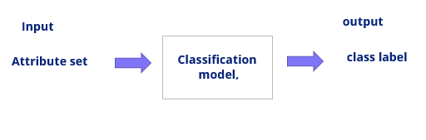
What is Classification
Classification is the process of constructing a model that classifies data based on the training set and uses it in classifying new data instances.
For example:
Countries based on climate
=============================================================================
WWW.THEMLLABS.COM || contact@themllabs.com || Phone : 91-7338339898, 91-6362546088

Slide 4
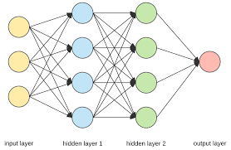
ANN Classifier
ANN Classification is the process of learning to separate samples into different classes by finding common features between samples of known classes.
=============================================================================
WWW.THEMLLABS.COM || contact@themllabs.com || Phone : 91-7338339898, 91-6362546088

Slide 5
Test Set - Classifying New instances
Training
Explore Data
Select Features
Train models
Assess Results
Testing
Prepare Dataset
Select Features
Features to Trained classifier
Assess Results
=============================================================================
WWW.THEMLLABS.COM || contact@themllabs.com || Phone : 91-7338339898, 91-6362546088

Slide 6
How to Measure Performance of Classifier
CONFUSION MATRIX
 | Predicted class
Actual class |  | A(yes) | B(no)
 | A(yes) | 74 (TP) | 64 (FN)
 | B(no) | 30 (FP) | 132 (TN)
Correctly classified instances : 206
Incorrectly classified instances : 94
Accuracy – (TP+TN)/(TP+TN+FN+FP)=206/300 = 68.6667 %
Error Rate – (FN+FP)/(TP+TN+FN+FP)=94/ 300 = 31.3333%
=============================================================================
WWW.THEMLLABS.COM || contact@themllabs.com || Phone : 91-7338339898, 91-6362546088

Slide 7
PERFORMANCE EVALUATION CLASS LABEL-YES
Precision: proportion of the predicted cases that were correct .
P= TP/(TP+FP)=74/104=.71
Recall or TP rate: proportion of positive cases that are correctly identified.
TPR= TP/(TP+FN)=74/138=.536
False Positive Rate (FP) : proportion of negatives cases that were incorrectly classified as positive.
FPR=FP/(FP+TN)=30/162=.185
F-Measure : is a combined measure for precision and recall. 2*Precision*Recall/(Precision + Recall)
=============================================================================
WWW.THEMLLABS.COM || contact@themllabs.com || Phone : 91-7338339898, 91-6362546088

Slide 8
PERFORMANCE EVALUATION CLASS LABEL-NO
Precision: proportion of the predicted cases that were correct
P= TN/(TN+FN)=132/(132+64)=.67
Recall or TP rate: proportion of positive cases that are correctly identified.
TPR= TN/(TN+FP)=132/162 = .81
False Positive Rate (FP) : proportion of negatives cases that were incorrectly classified as positive.
FPR=FN/(TP+FN)=64/138=.46
F-Measure : is a combined measure for precision and recall.
2*Precision*Recall/(Precision + Recall)
=============================================================================
WWW.THEMLLABS.COM || contact@themllabs.com || Phone : 91-7338339898, 91-6362546088

Slide 9
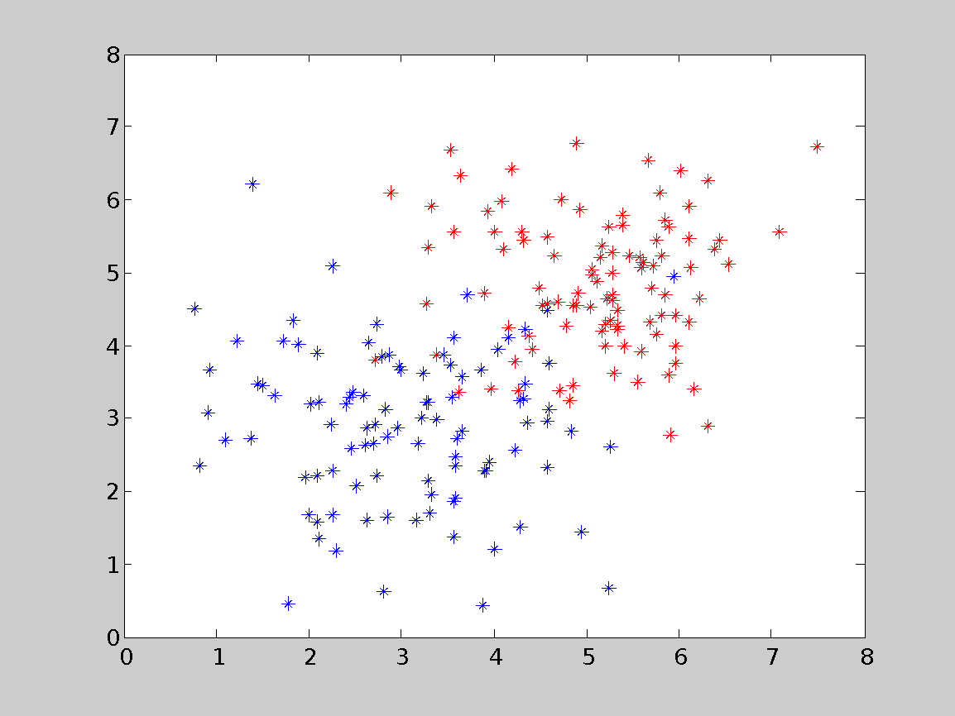
Classification problem with overlap
=============================================================================
WWW.THEMLLABS.COM || contact@themllabs.com || Phone : 91-7338339898, 91-6362546088

Slide 10
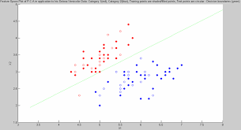
Decision boundaries
=============================================================================
WWW.THEMLLABS.COM || contact@themllabs.com || Phone : 91-7338339898, 91-6362546088

